Slide 1
Analysis of 9 days dataset – 4th to 12th May
Expect channels 0 to 22 to be similar (new PMTs), tested by overlapping channels 6 and 7
Repeated the above for old and new PMTs connected to calo 18 – ch 8 (new) and ch 28 (old)
A study of channel 8 (new PMT) and 28 (old PMT) connected to calo 18.
Displayed A1 and A2 on the same plot and A2:A1 separately
Just mentioned max. range of variation of A1 and A2 (straight line fit did not make sense especially for channel 8).
Fitted A2:A1 with a straight line as before.
Finally found an abrupt change in temperature data, so split this dataset into two parts of about 4.5 days each

Slide 2
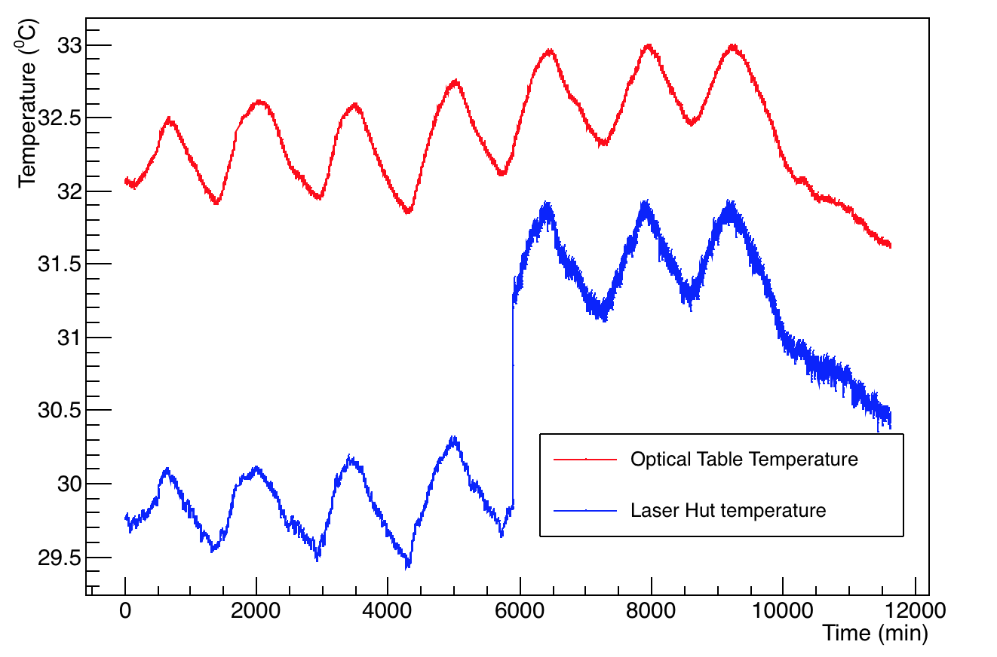
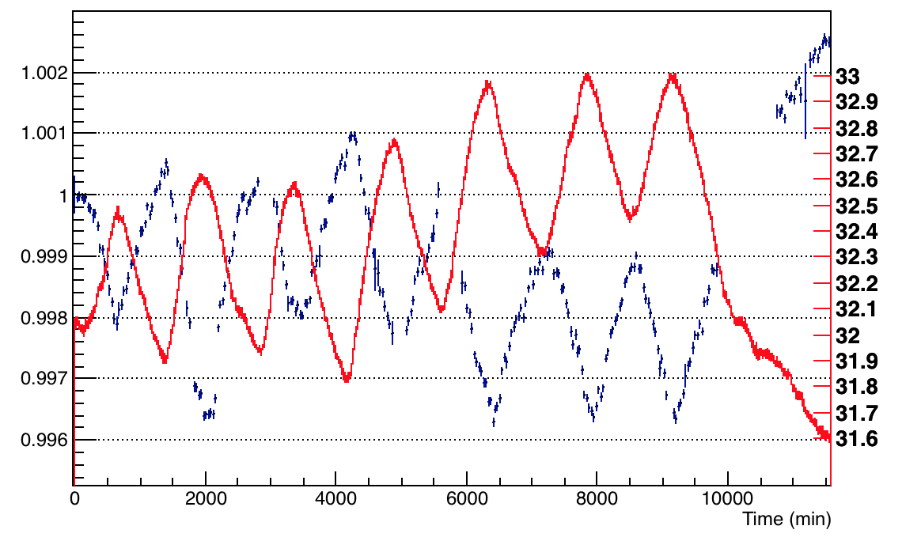
Temperature Plots - A1 with optical table temperature
Something changed abruptly in the laser hall temperature, so used optical table temperature for analysis. Also divided the dataset in 2 sets – 0 to 5700s and 6000s to 12000s.
Temperature (ºC)
A1 (Normalized)
Set I
Set II

Slide 3
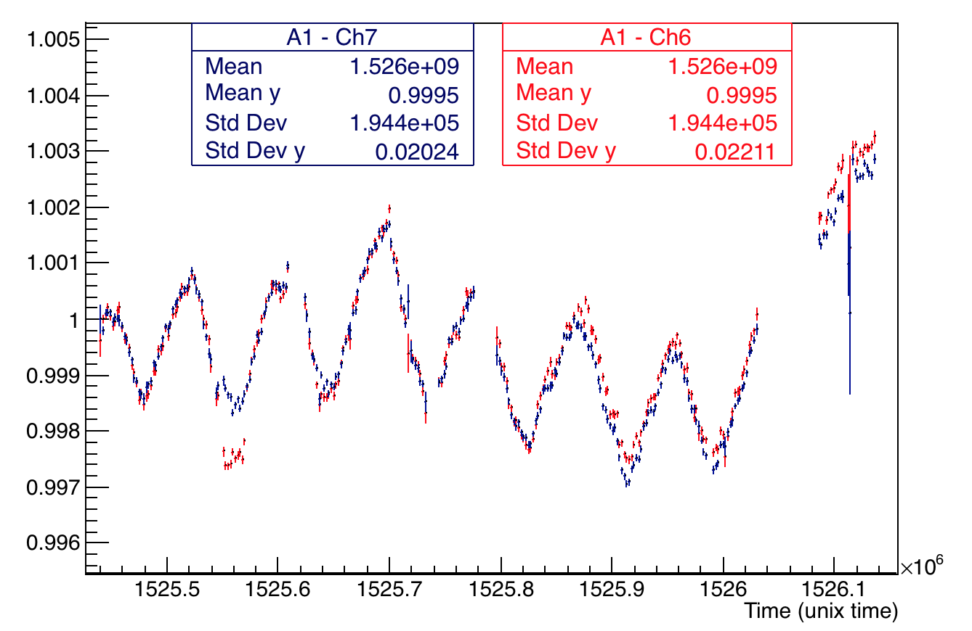
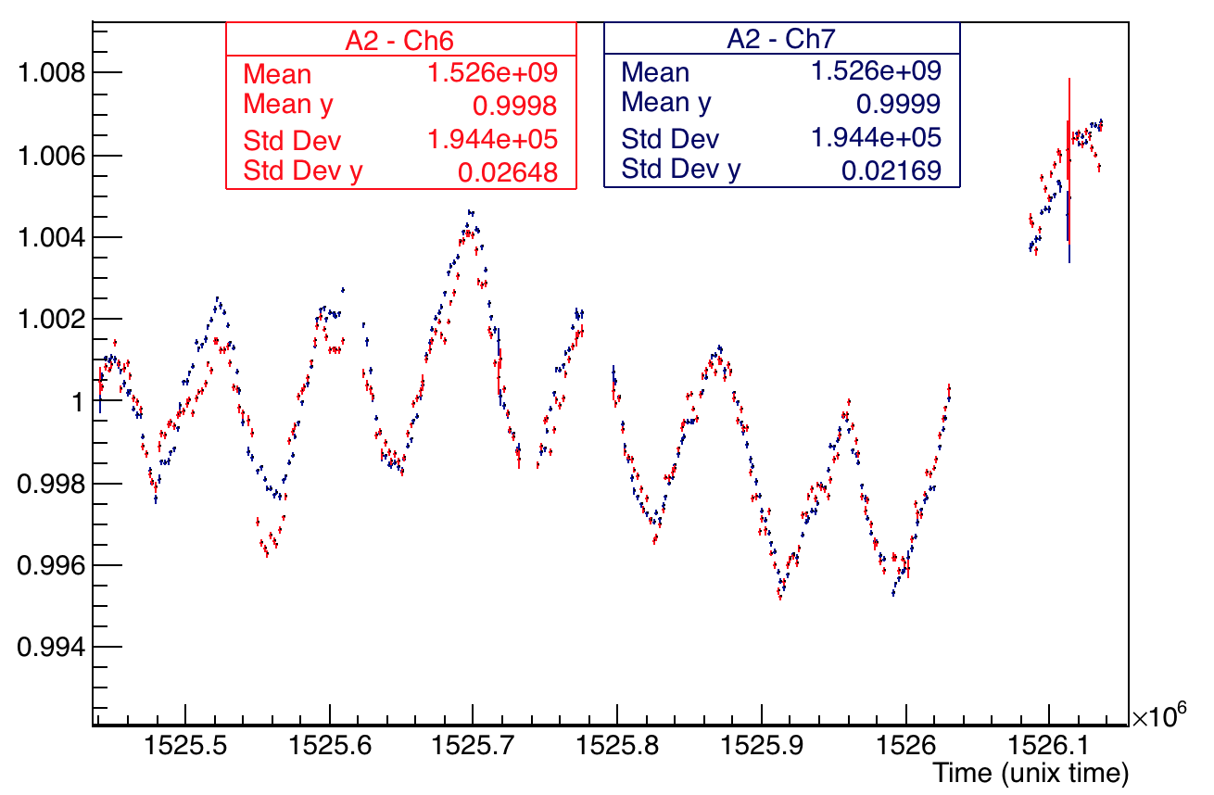
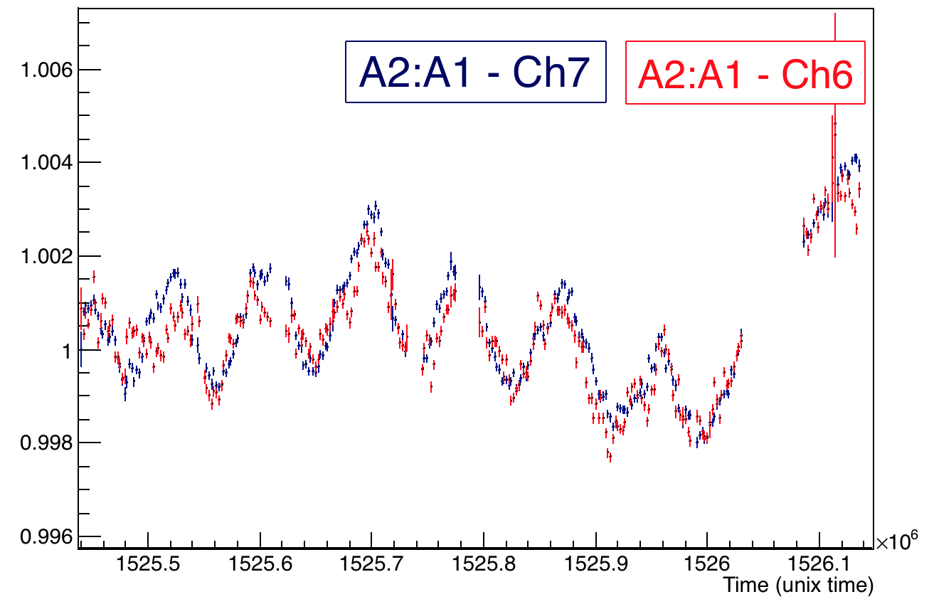
Channels 6 and 7 - comparison
A2
A1
Purpose – expected that all new PMTs show similar behaviour (these are comparable). Checked channel 6 and 7. Normalized with the mean of first 9 bins.
A2:A1

Slide 4
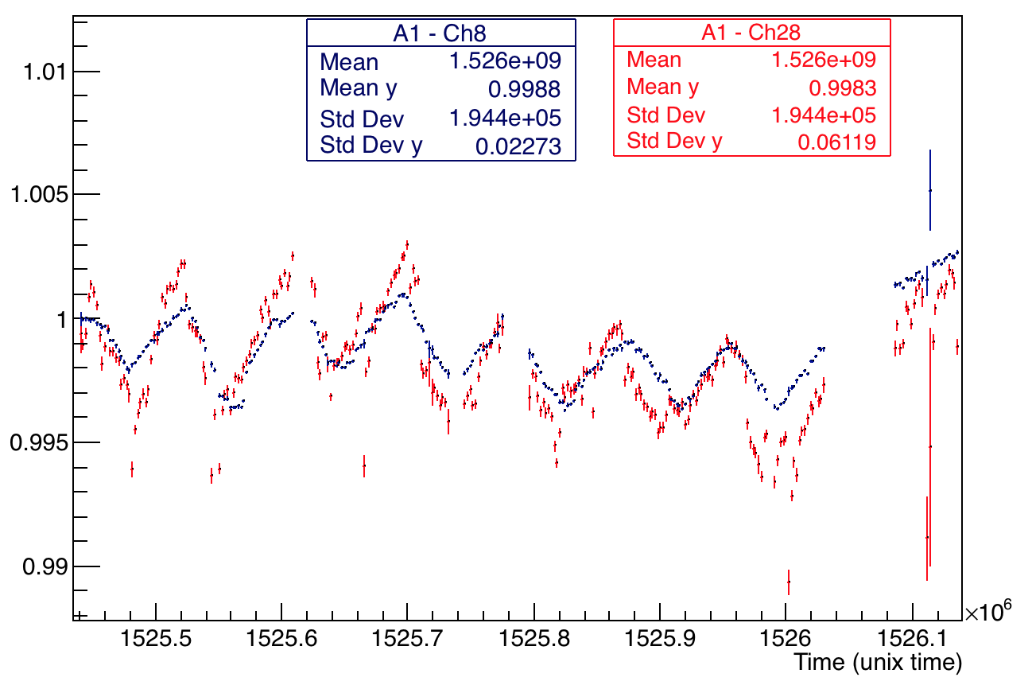
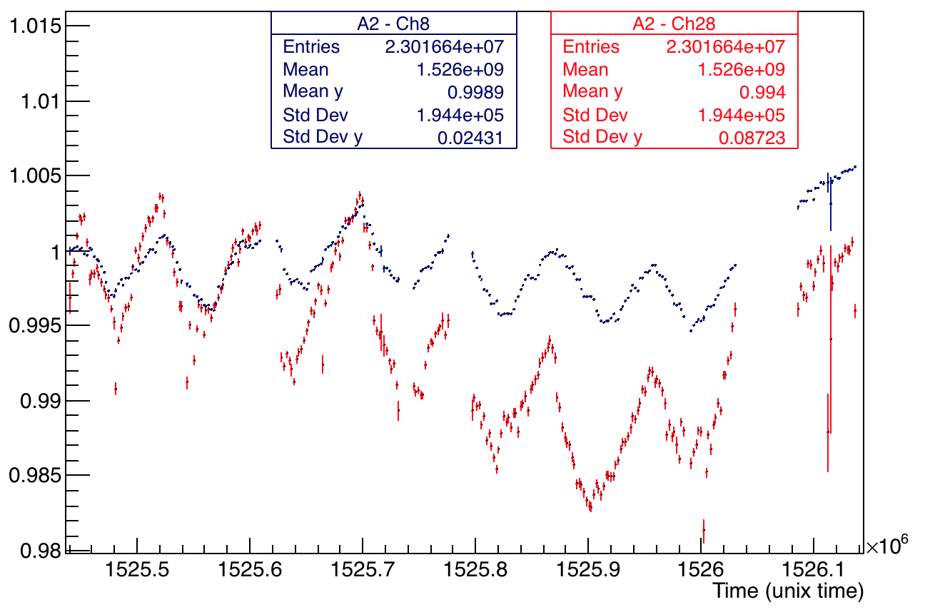
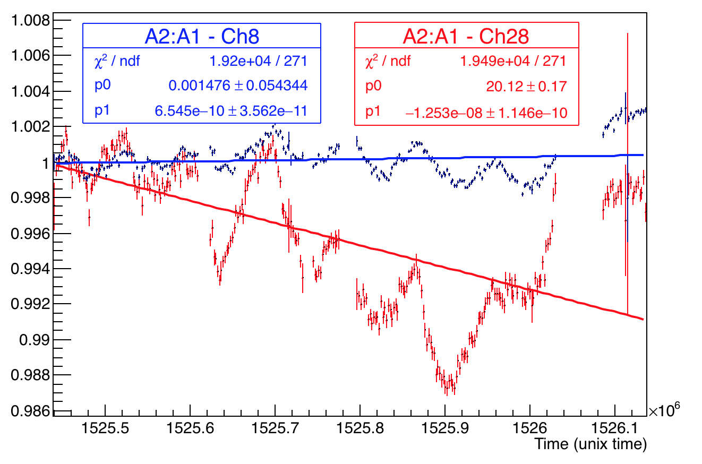
Calo 18 – Channels 28 and 8 - comparison
Max range = 7.23x10⁻⁷/min
Max range = 8.036x10⁻⁷/min
A1
Max range = 5.032x10⁻⁷/min
A2
Max range = 1.6x10⁻⁶/min
Should show different behaviour (as the PMTs are different and old PMTs use a PMMA return fibre and Silica forward fiber whereas the new one uses only Silica). This is evident here.
A2:A1

Slide 5
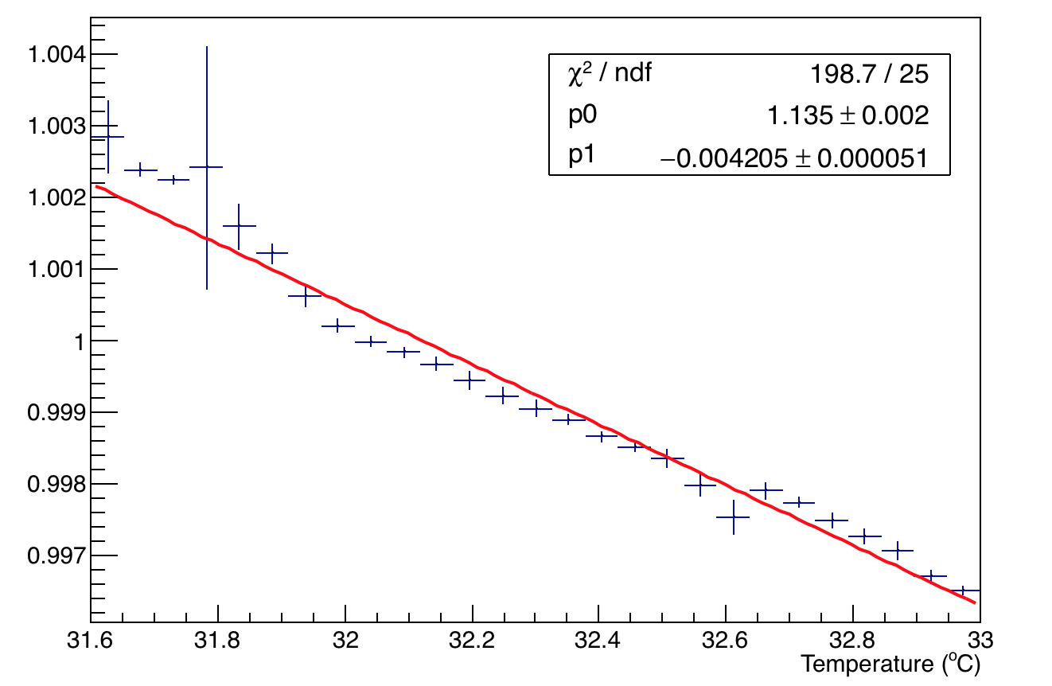
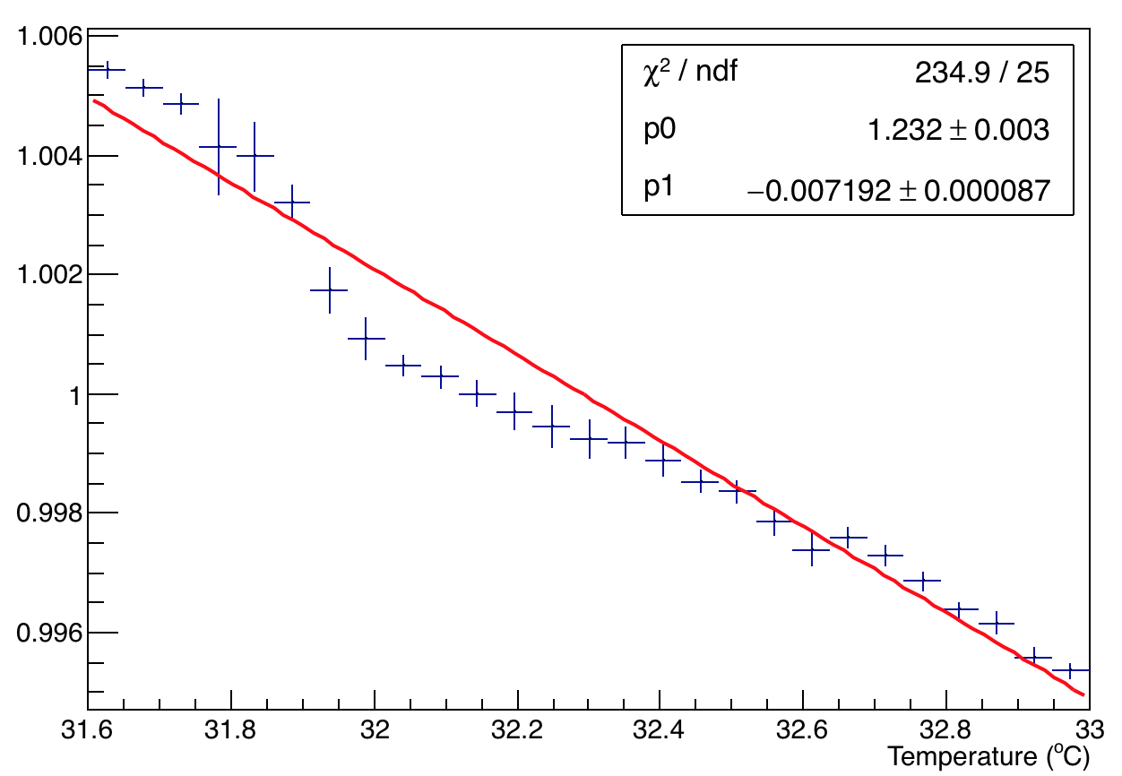
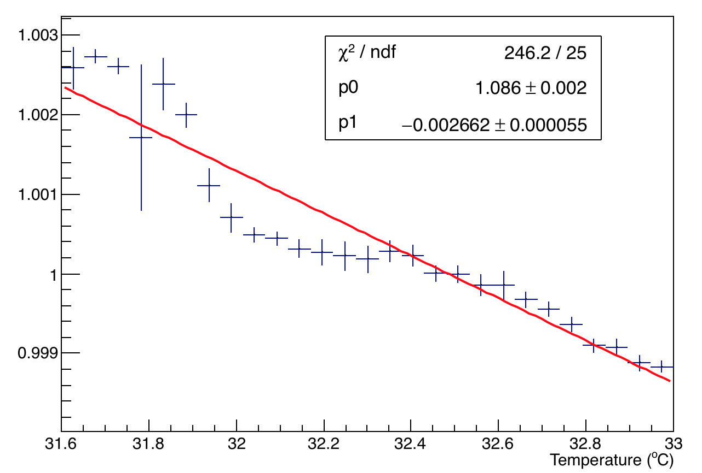
Temperature studies of channel 8 – Linear fit
A1
A2
New PMT – Silica fiber both forward and return directions
A2:A1

Slide 6
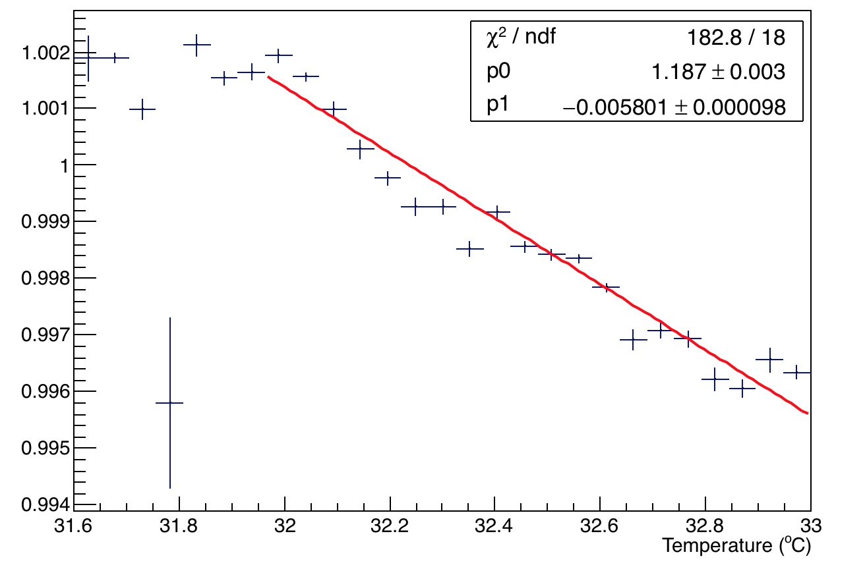
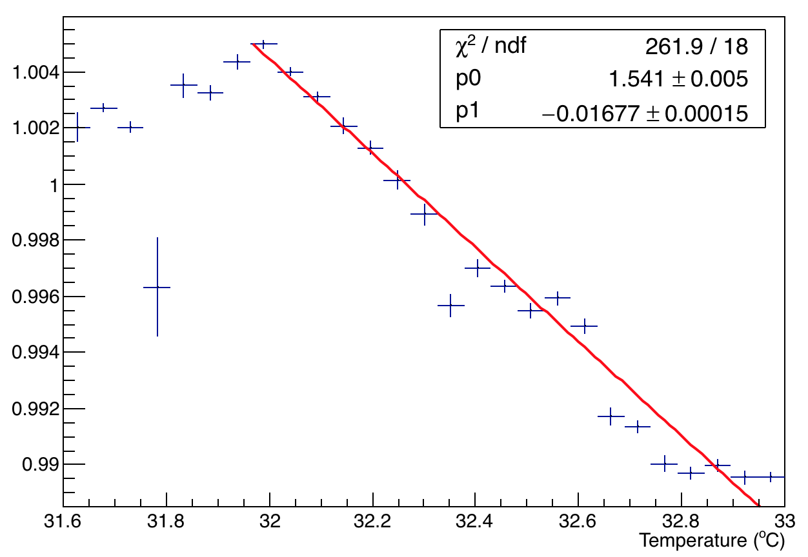
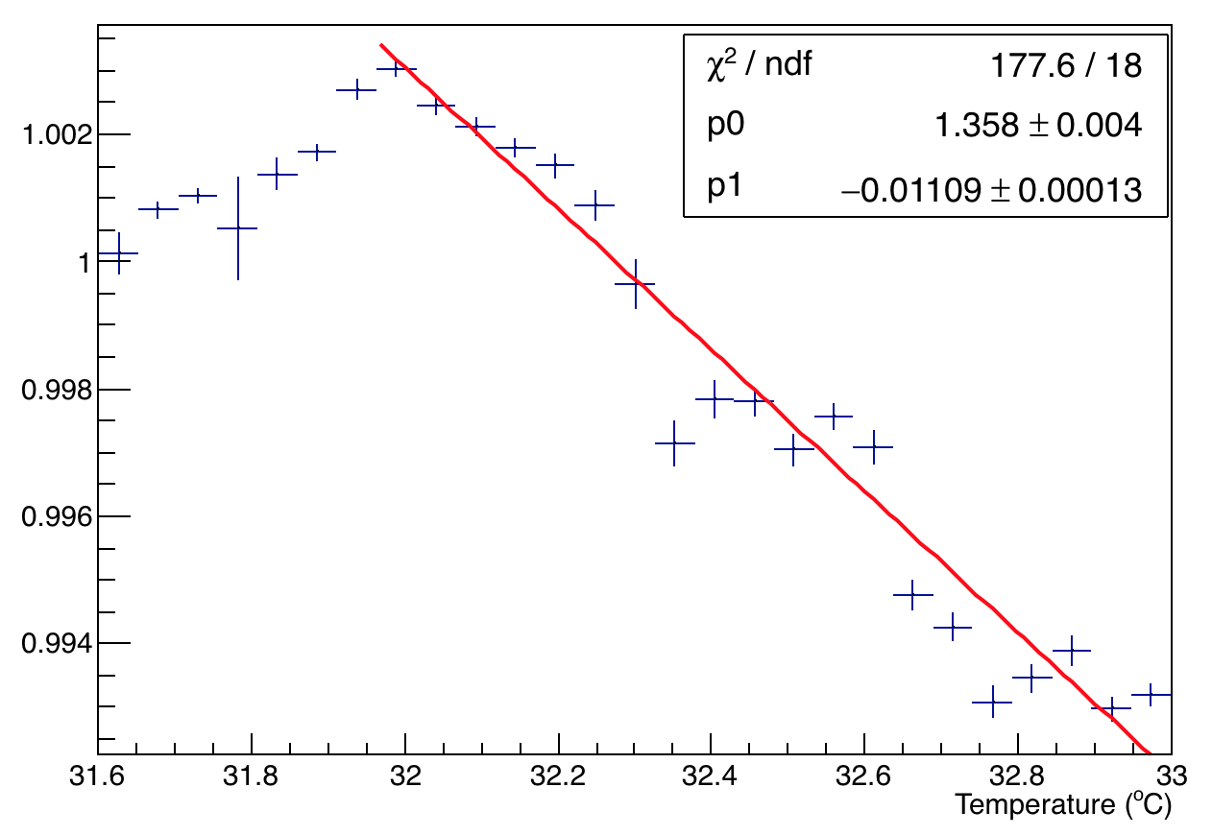
Temperature studies of channel 28 – Linear fit
A1
A2
Old PMT – PMMA fiber in the return direction. Thus A2 = Silica forward + PMMA return
A2:A1

Slide 7
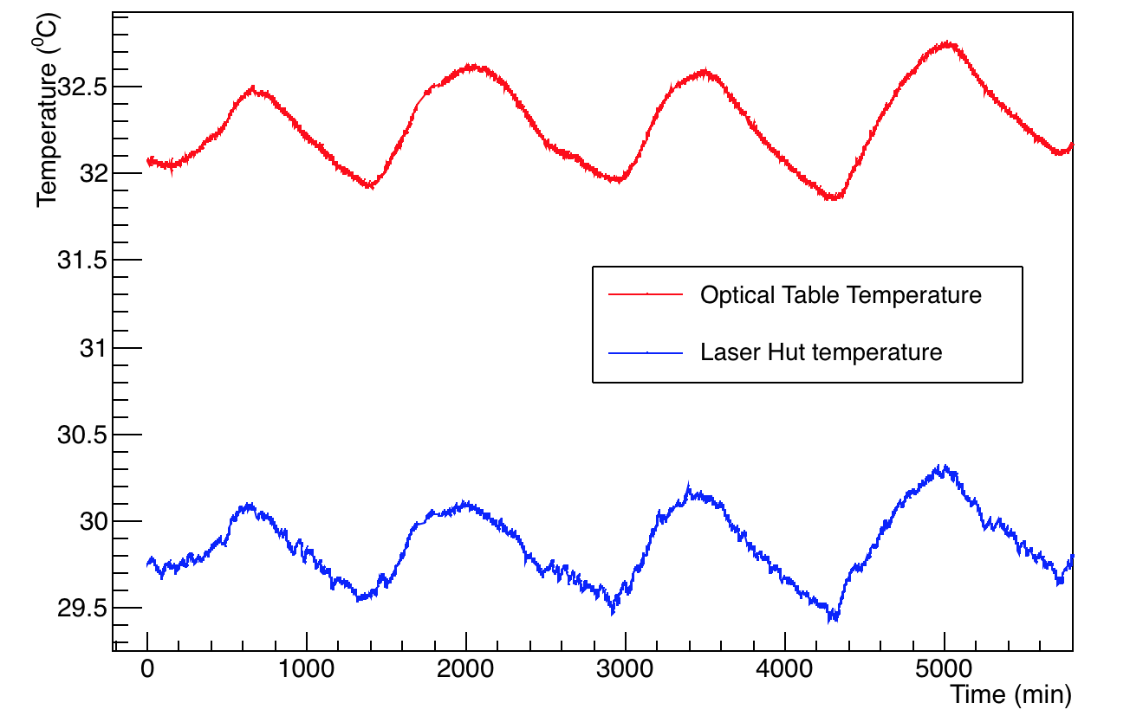
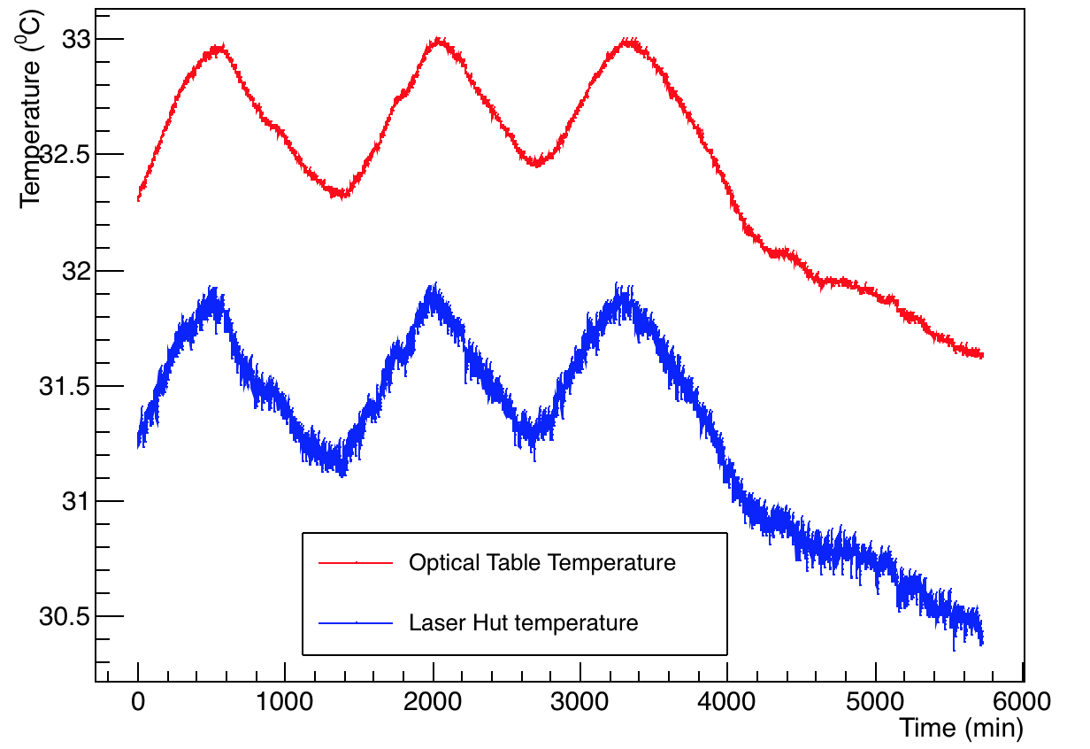
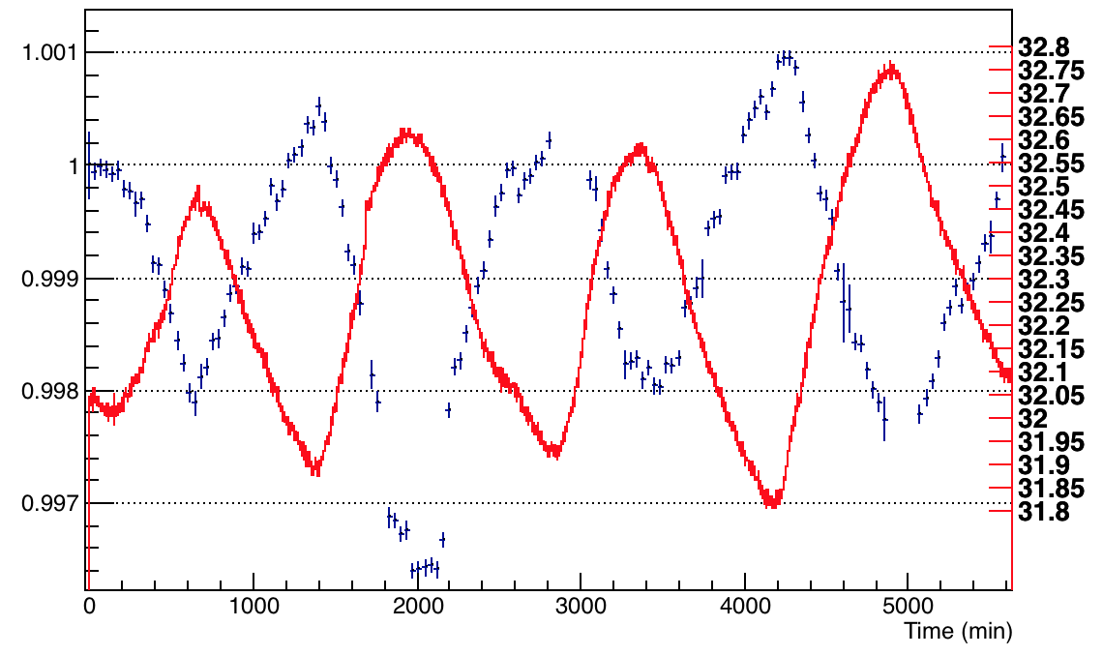
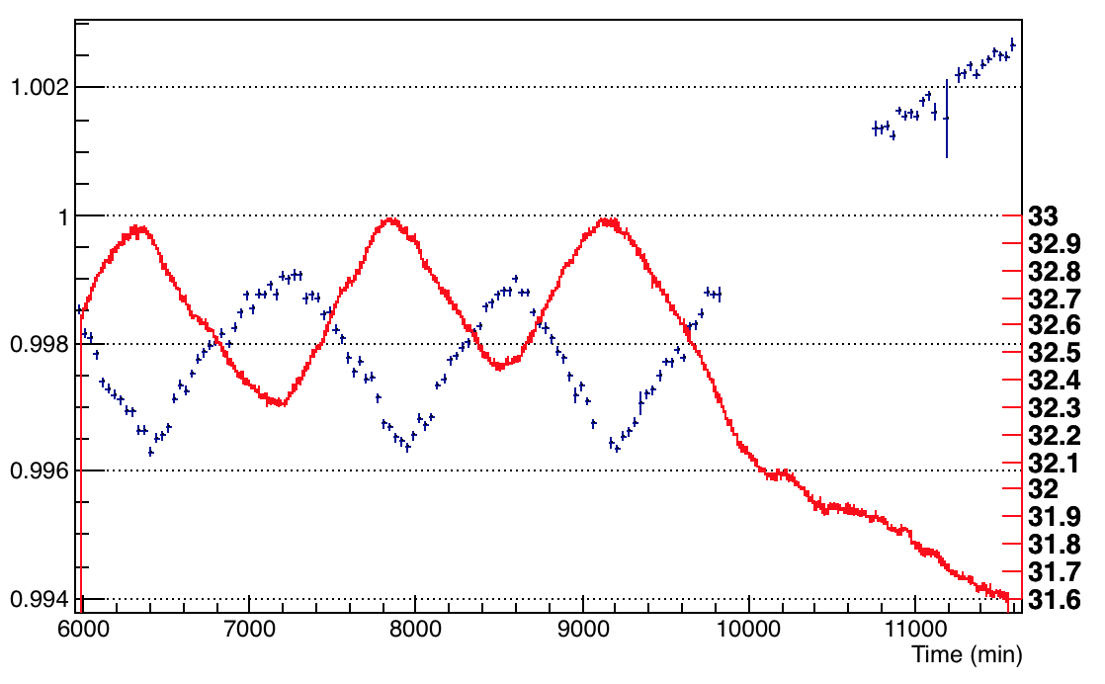
Investigation for the two sets (or parts) separately
Set II
Set I
Temperature (ºC)
A1 (Normalized)
A1 normalized
0 1000 2000 3000 4000 5000
Time (min)

Slide 8
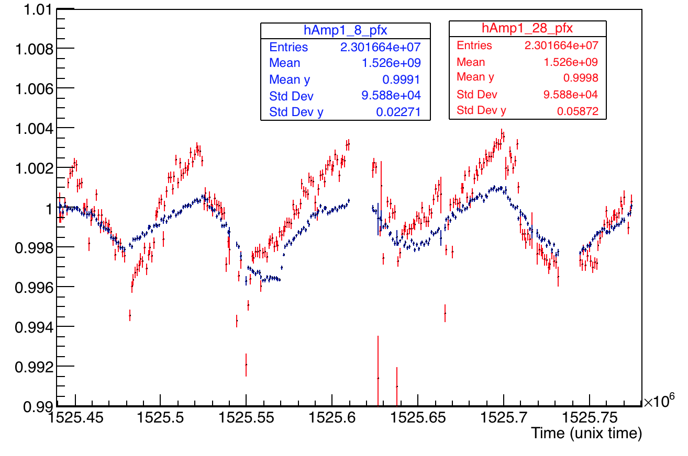
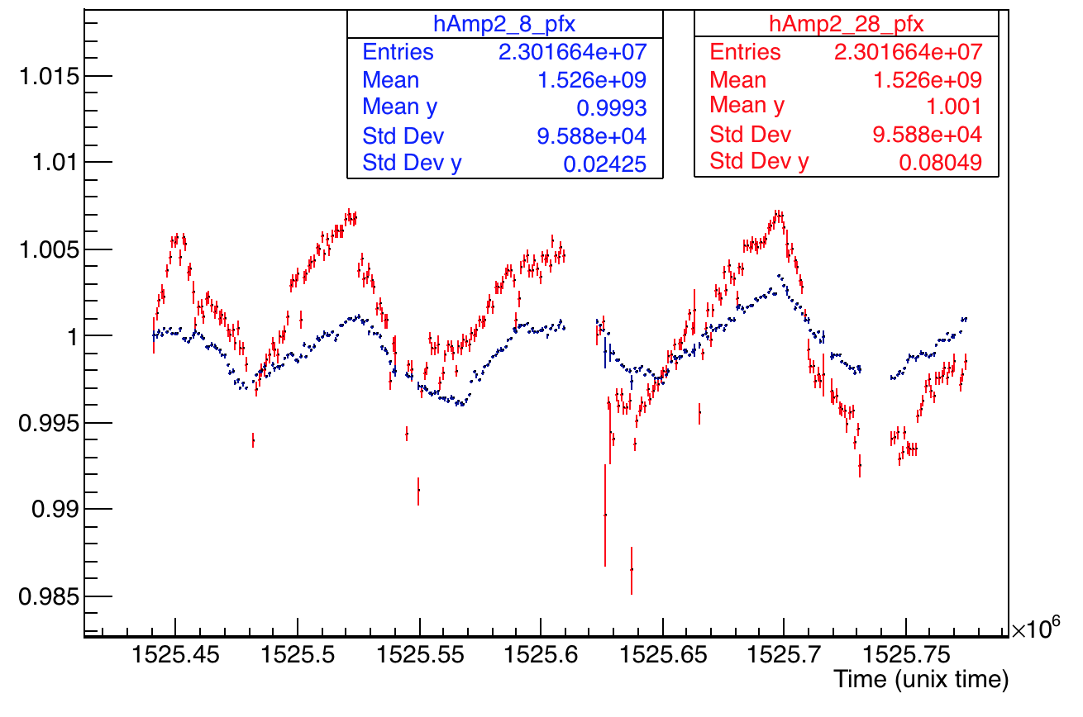
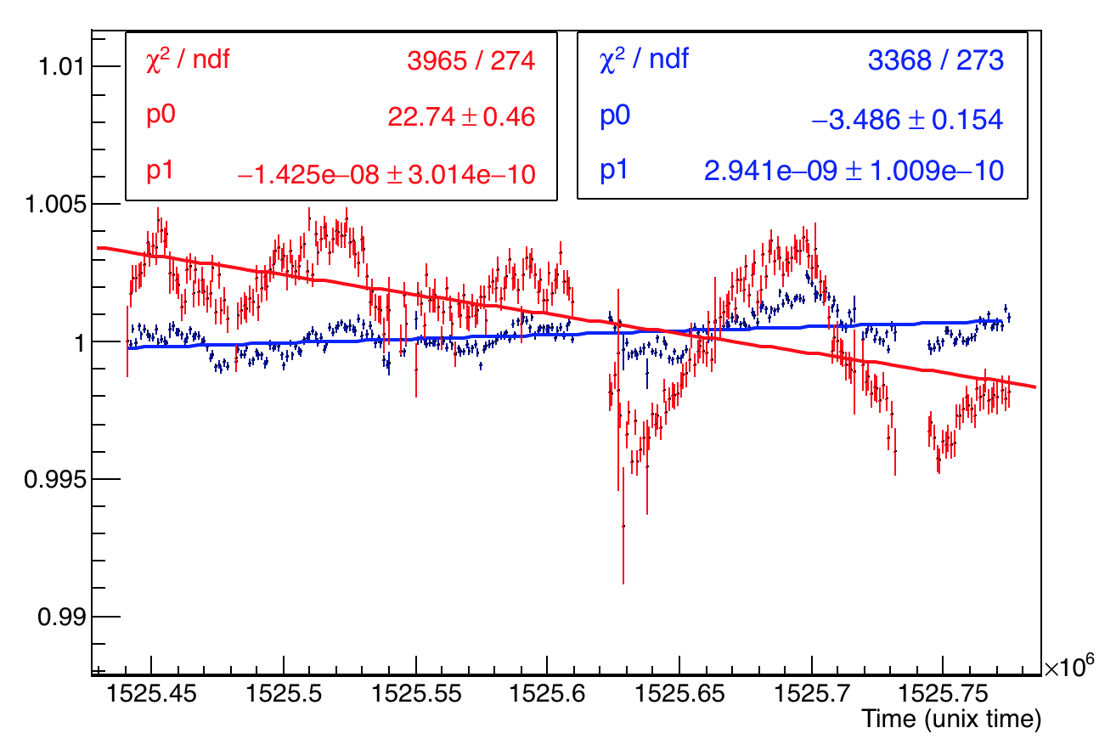
Calo 18 – Channels 28 and 8 – comparison – Set I
A1
A2
Should show different behaviour (as the PMTs are different and old PMTs use a PMMA return fibre and Silica forward fiber whereas the new one uses only Silica). This is evident here.
A2:A1

Slide 9
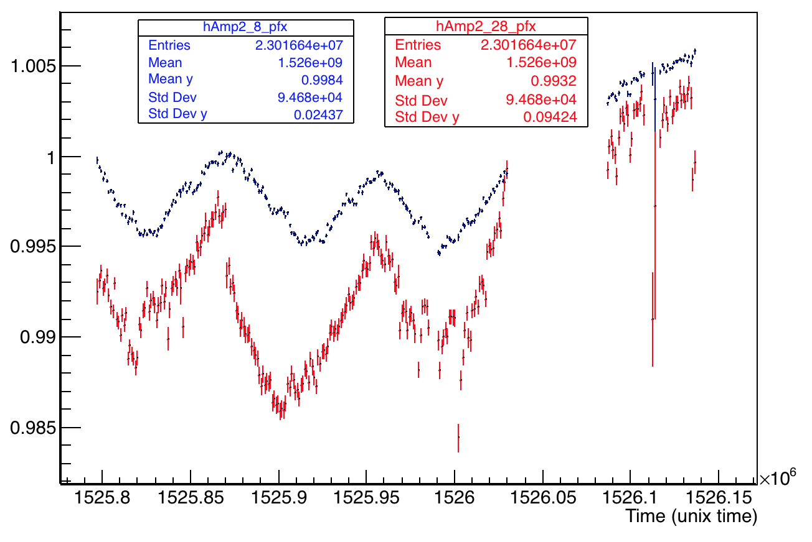
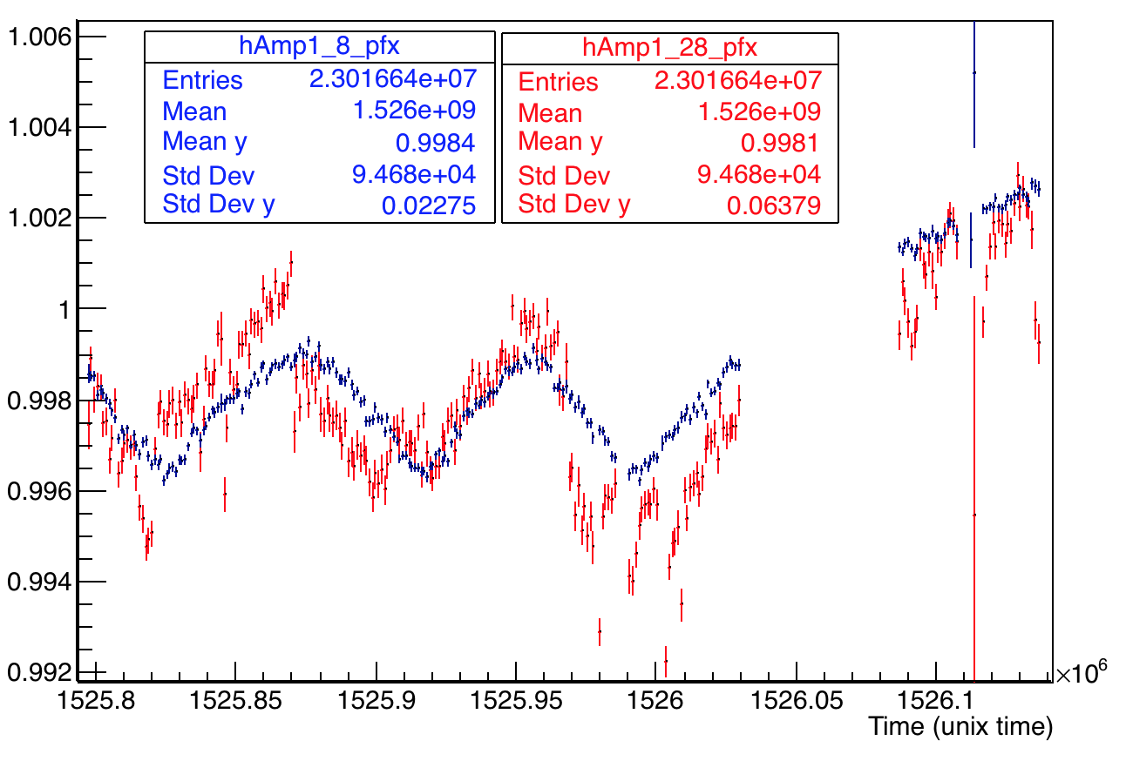
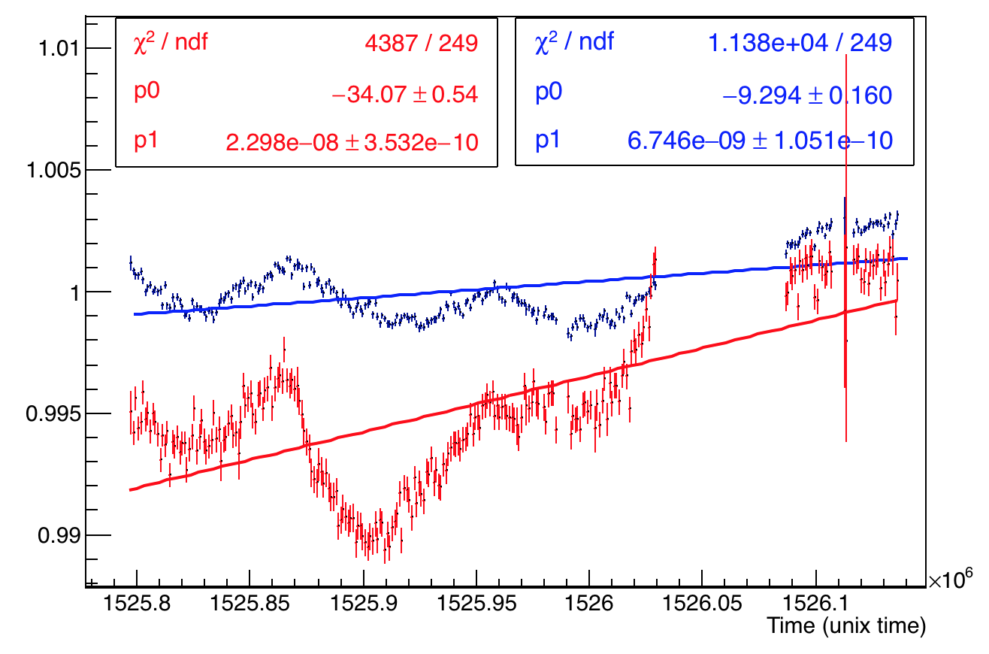
Calo 18 – Channels 28 and 8 – comparison – Set II
A1
A2
Should show different behaviour (as the PMTs are different and old PMTs use a PMMA return fibre and Silica forward fiber whereas the new one uses only Silica). This is evident here.
A2:A1

Slide 10
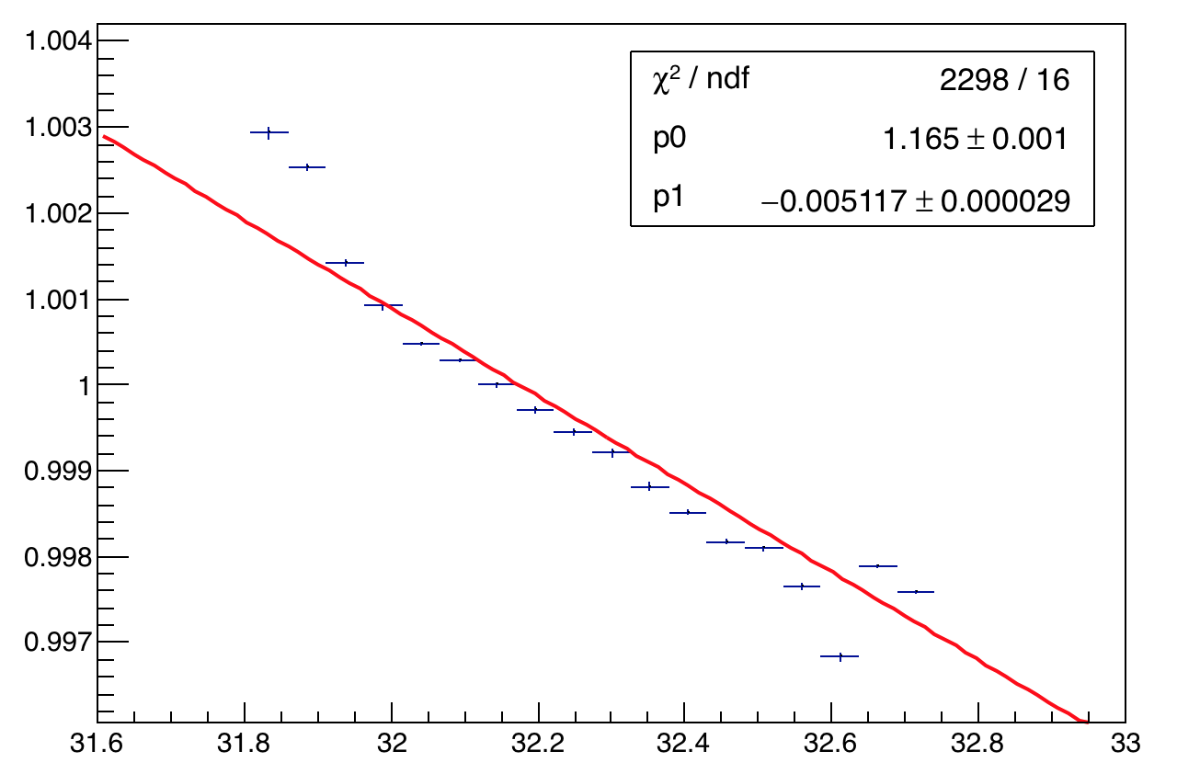
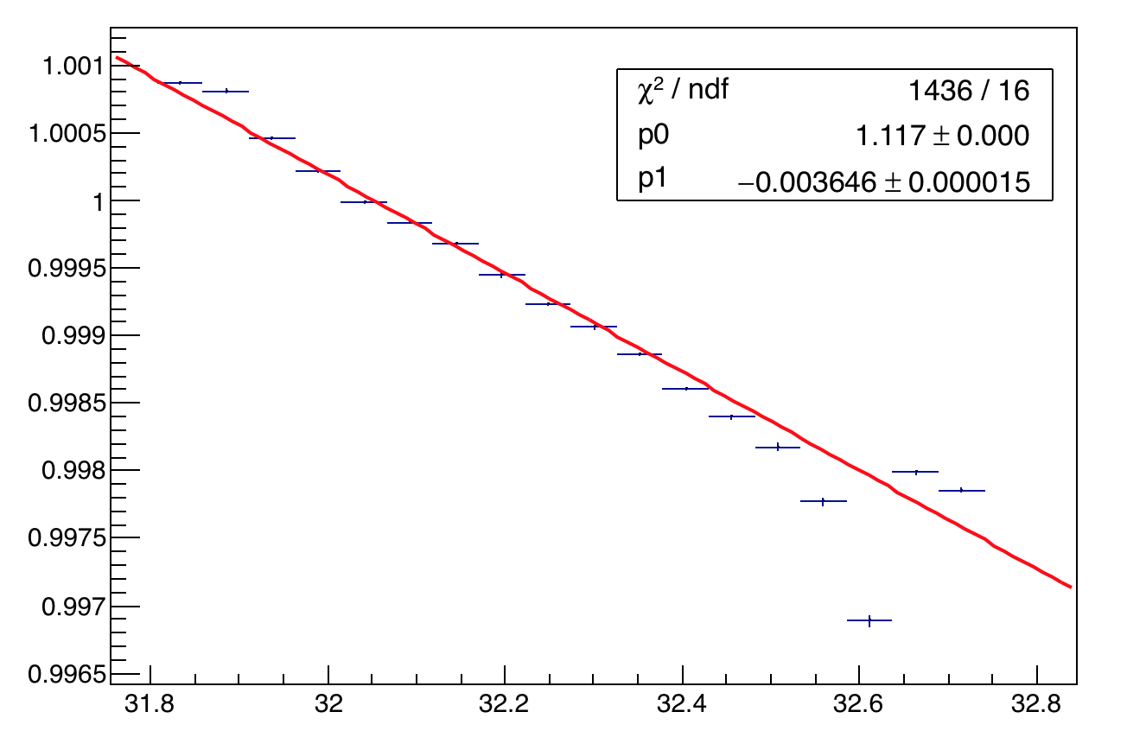
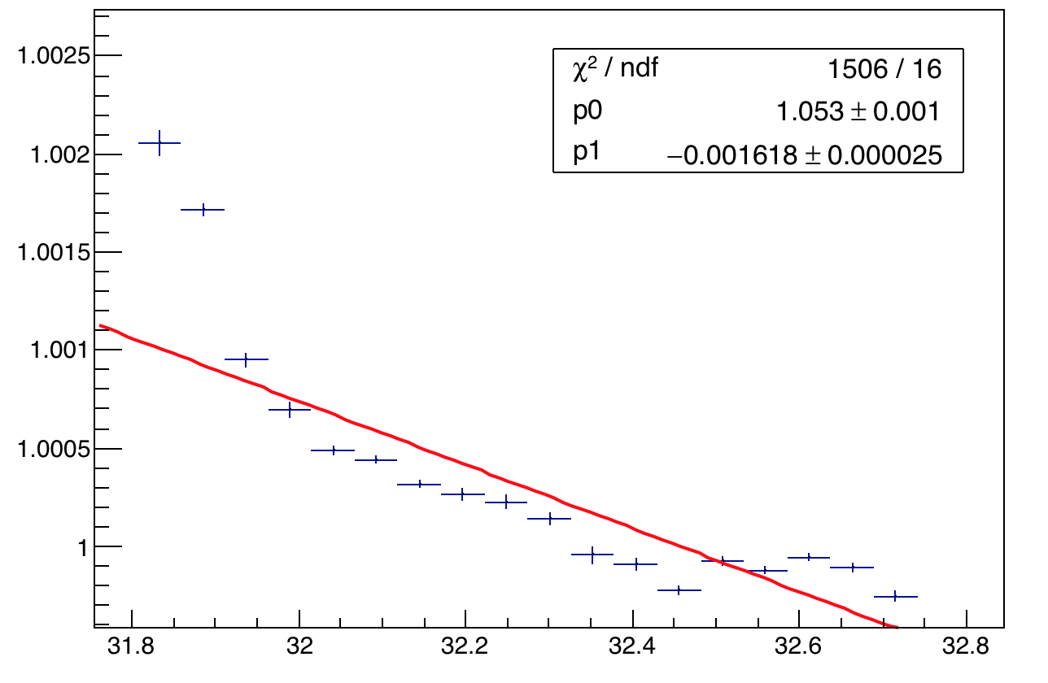
Temperature studies of channel 8 – Set 1
A1
A2
New PMT – Silica fiber both forward and return directions
A2:A1

Slide 11
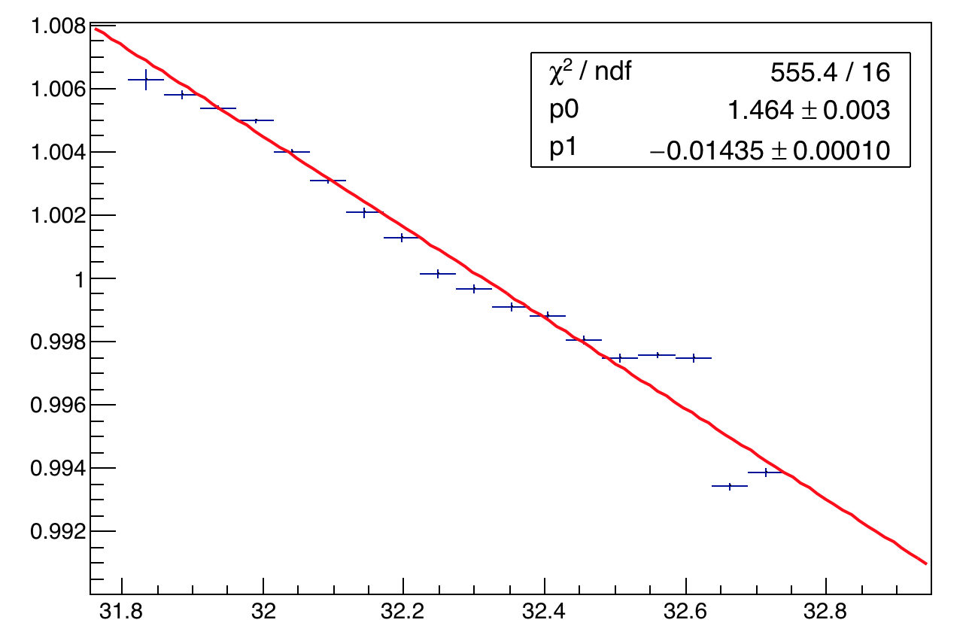
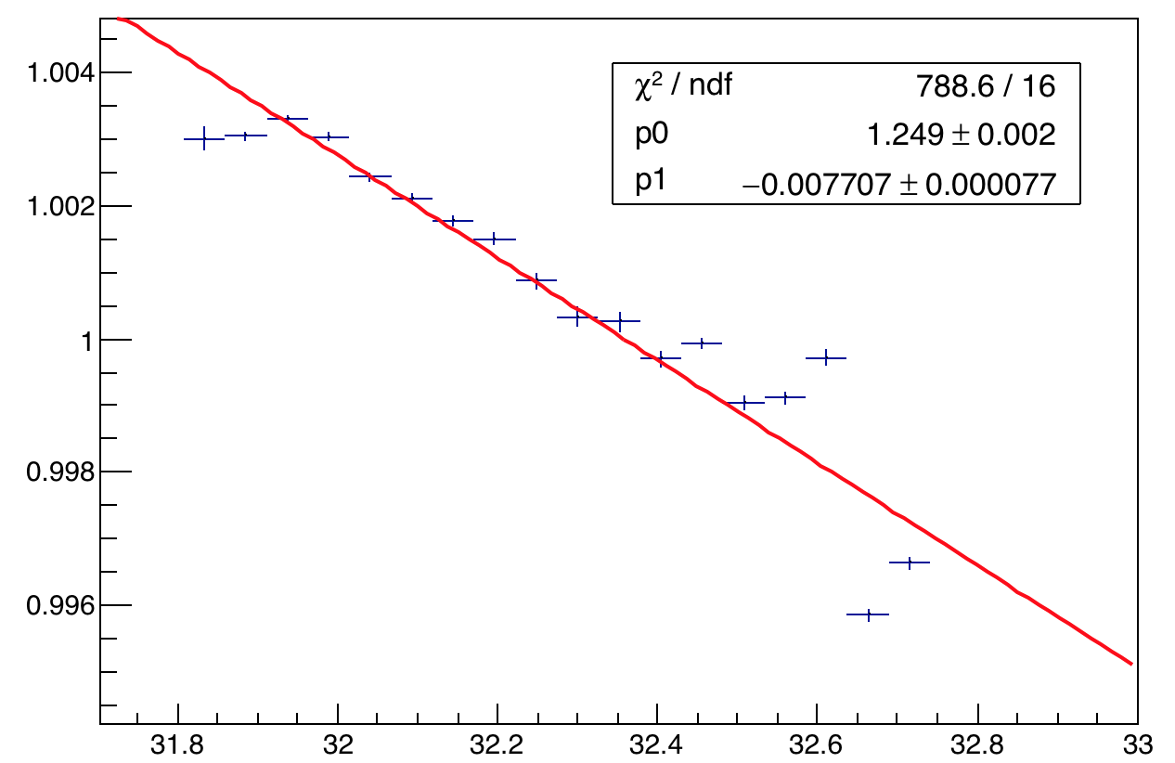
Temperature studies of channel 28 – Set I
A1
A2
Old PMT – PMMA fiber in the return direction. Thus A2 = Silica forward + PMMA return
A2:A1

Slide 12
Conclusions
Variation of A1 with temperature shows a negative correlation of PMT gain with temperature (as expected)
A2:A1 is almost constant with time for the (for longer time ranges some the variation appears especially for the old PMTs)
Channels 0 to 23 i.e. the new PMTs (refer slide 9) show a comparatively stable A2:A1 drop with temperature (it ranges from ~0.1% to 0.45%) which is much better than the old PMTs
Old PMTs show a much larger change with temperature (probably expected) – besides the return fiber of all PMTs is a PMMA, which has shown to display a greater loss.

Slide 13
Back up slides

Slide 14
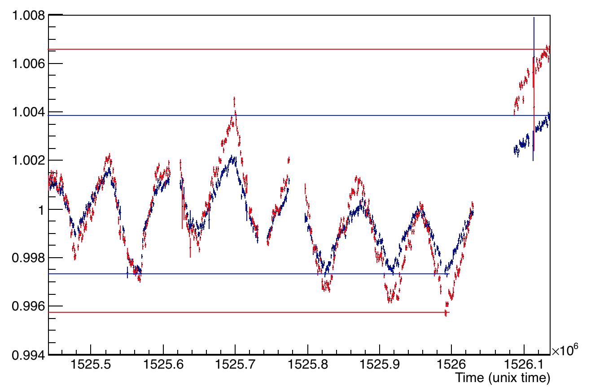
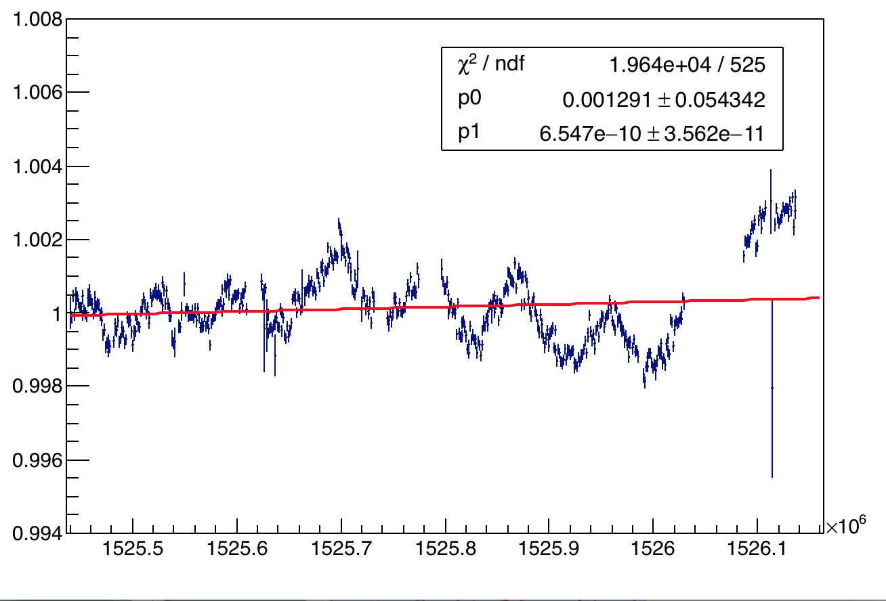
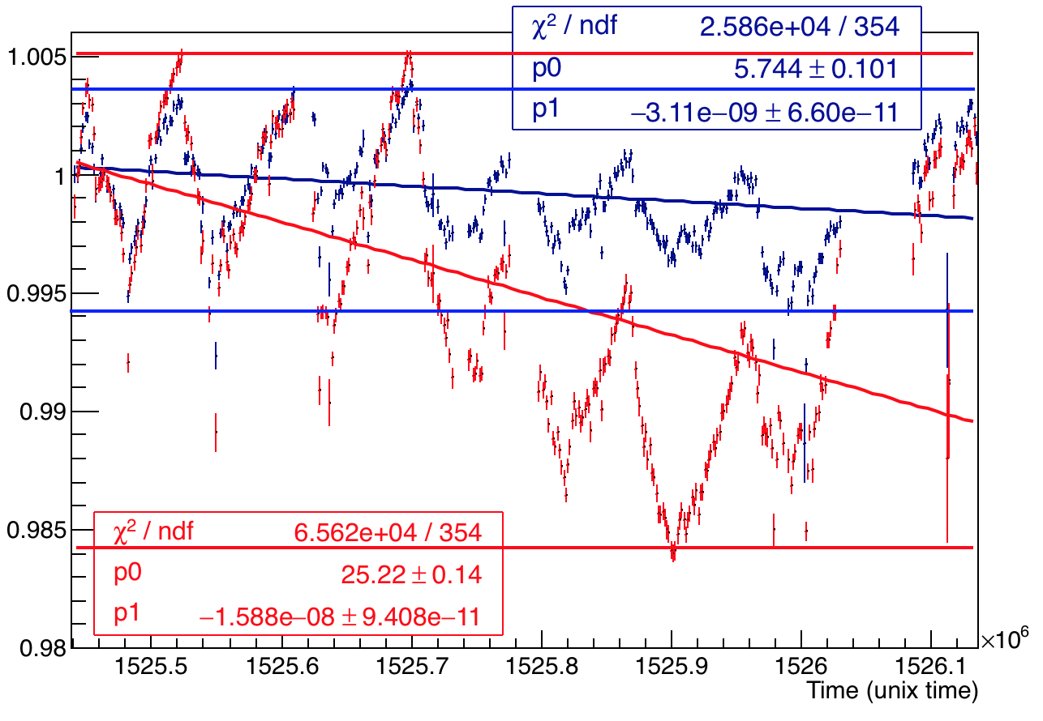
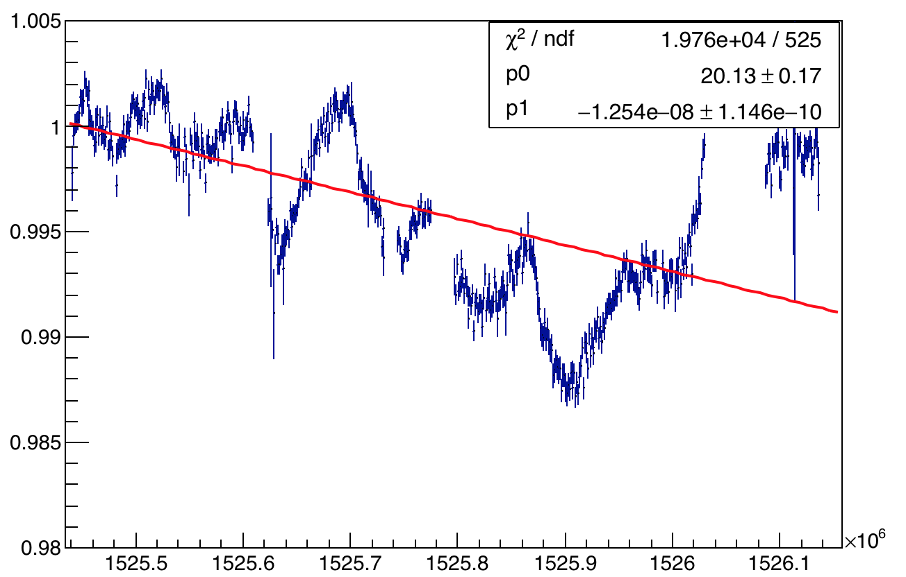
Calo 18 - A1 and A2 overlaid and A2:A1
A2 max range = 8.036x10⁻⁷/min
A1 max range = 5.032x10⁻⁷/min
Channel 8 – New PMT
A2:A1
A1 max range = 7.23x10⁻⁷/min
A2 max range = 1.6x10⁻⁶/min
A2:A1
Channel 28 – Old PMT

Slide 15
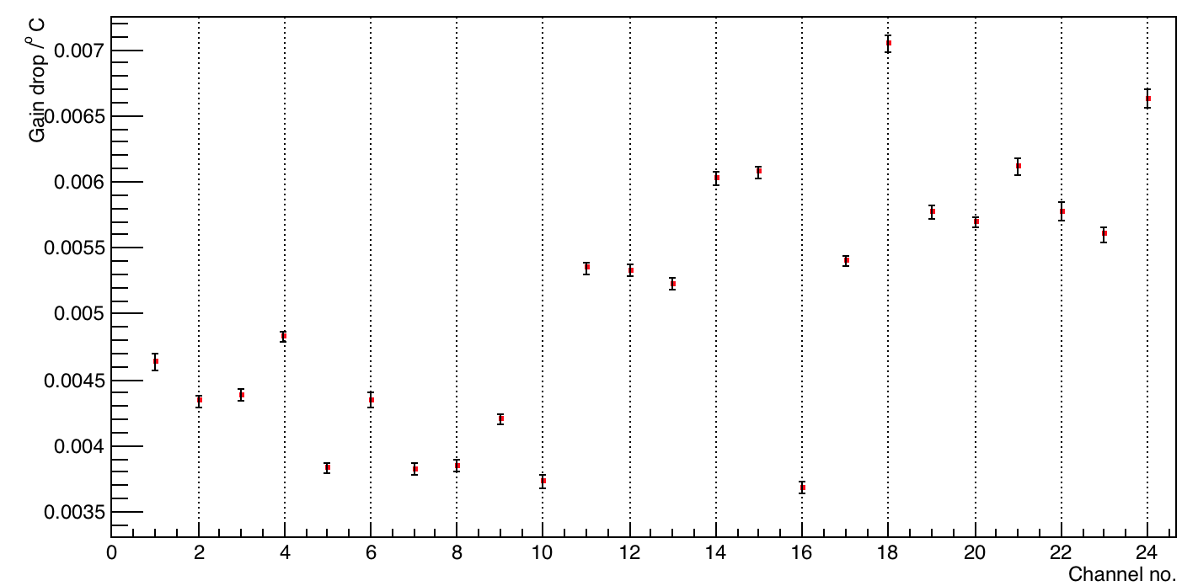
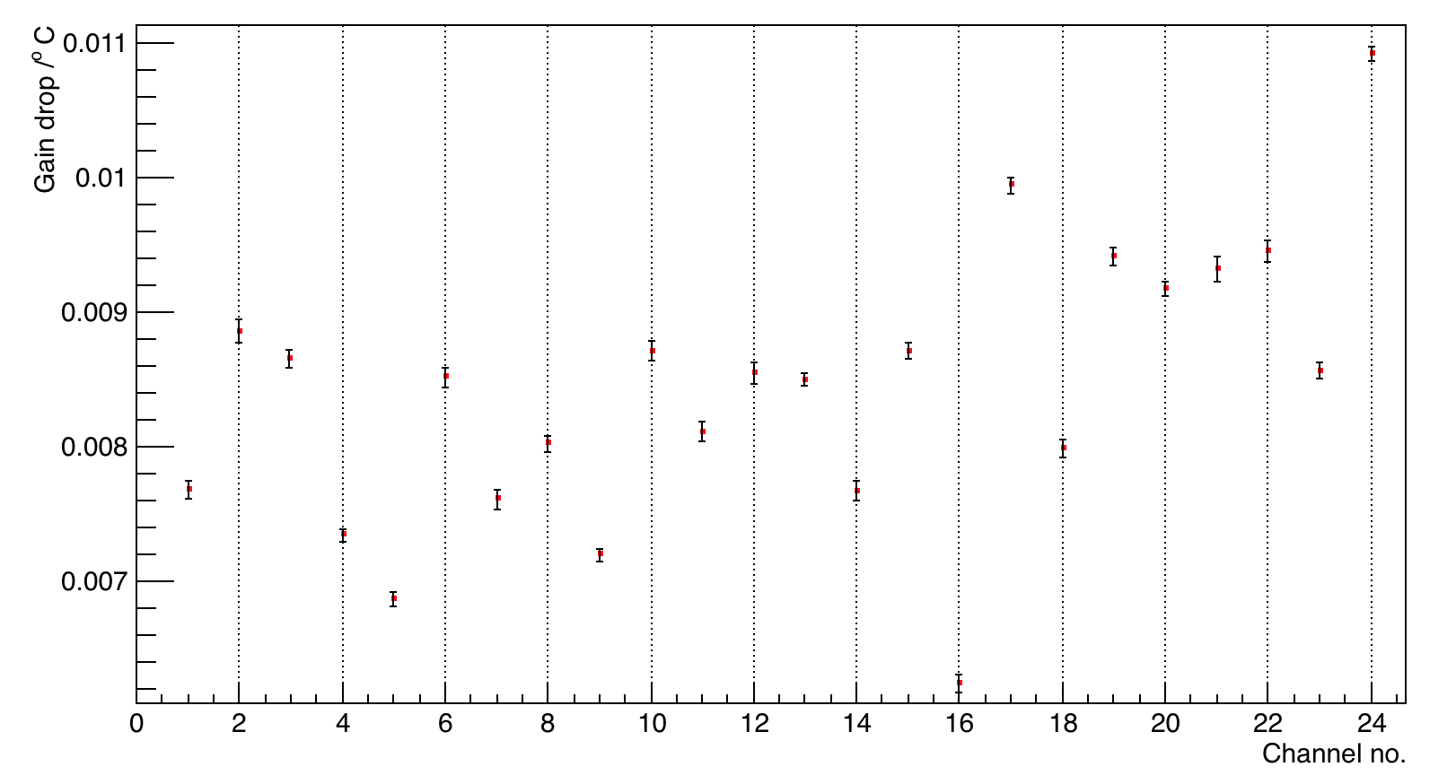
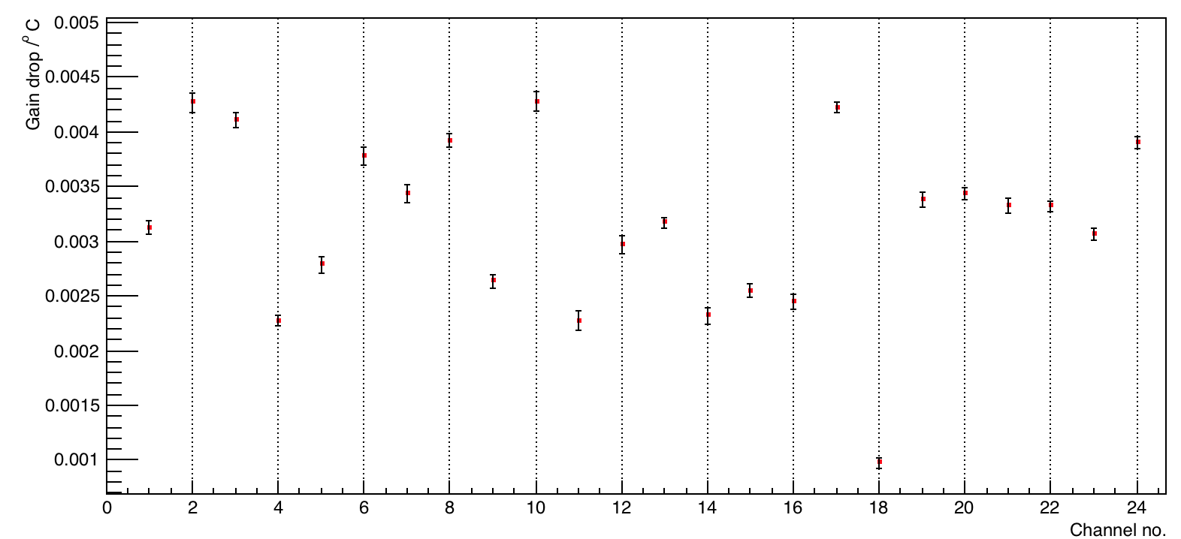
Drop in gain for rest channels – 0 to 23
A1
A2
Results obtained by linear fits of each channel.
A2:A1

Slide 16
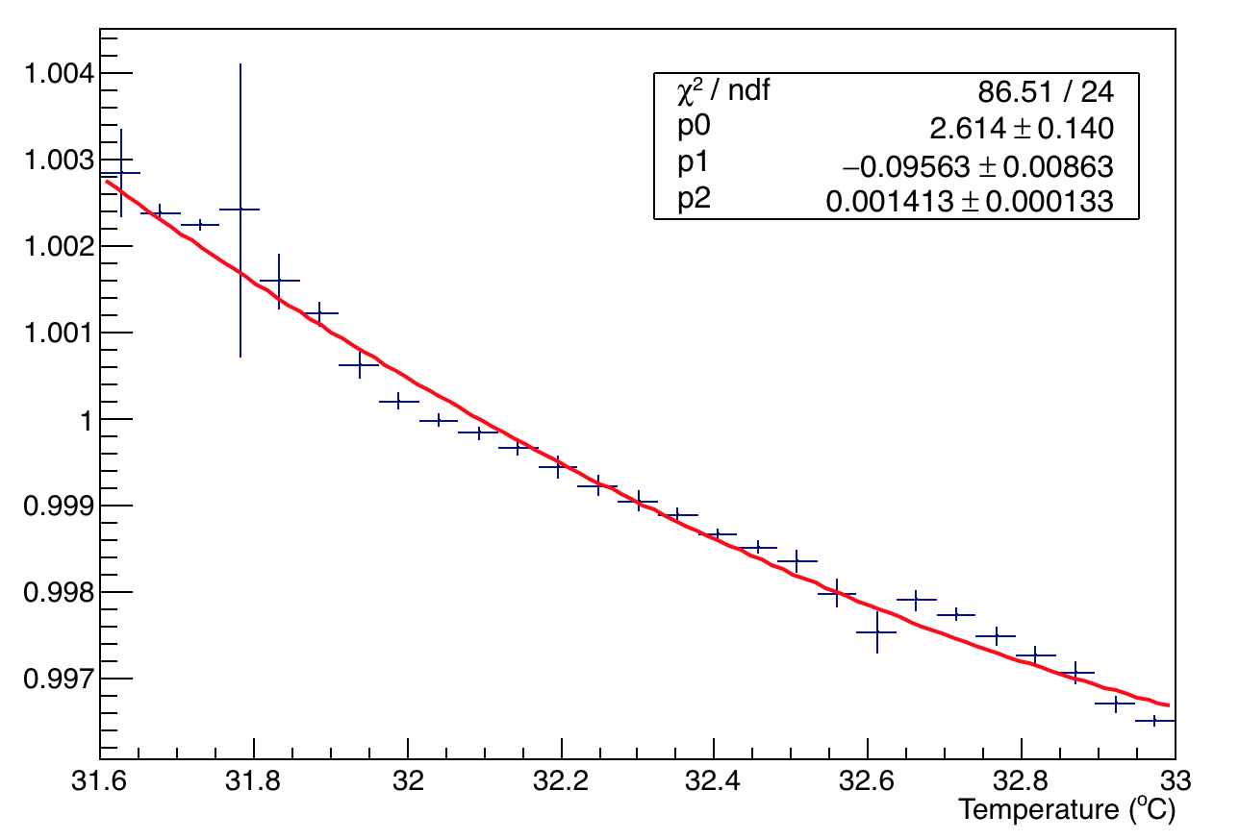
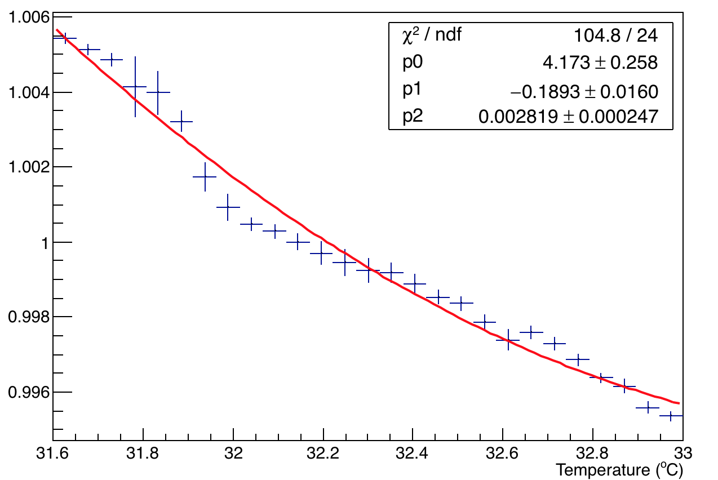
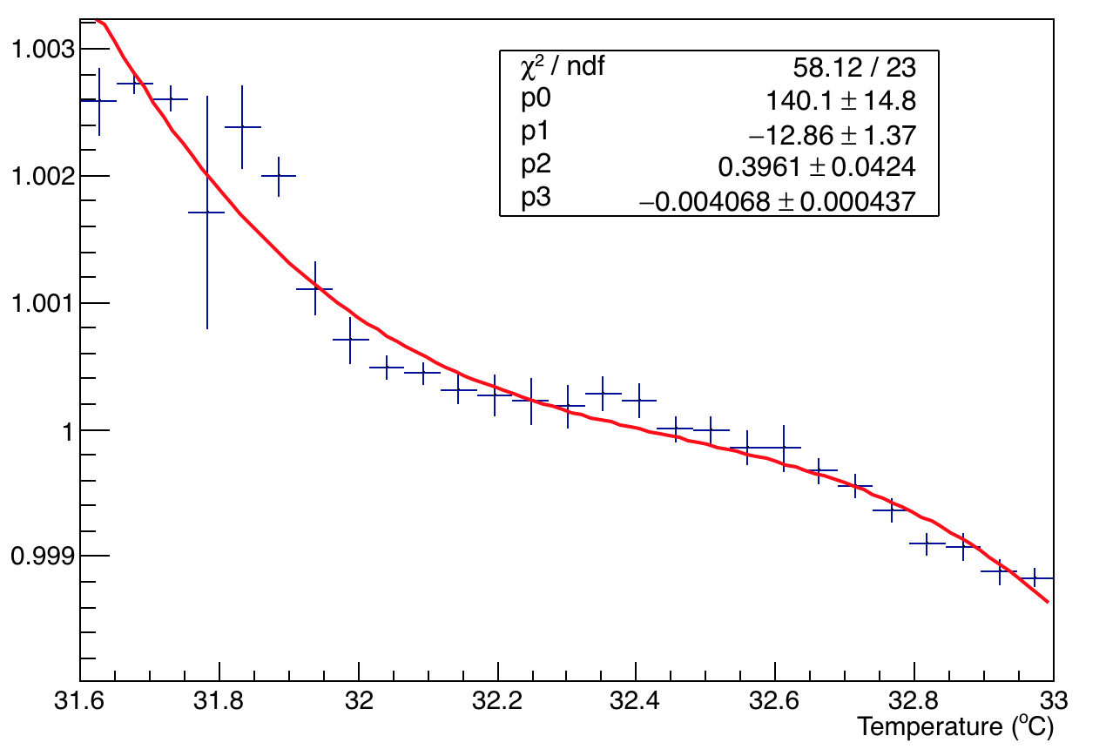
Temperature studies of channel 8
A1
A2
Used quadratic fit for A1 and A2 – gives better chi2. A cubic fir for A2:A1
A2:A1

Slide 17
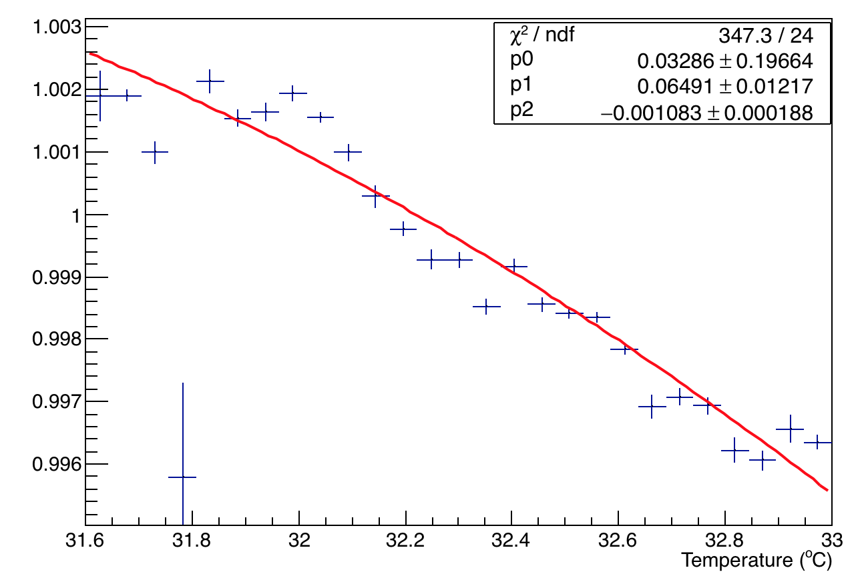
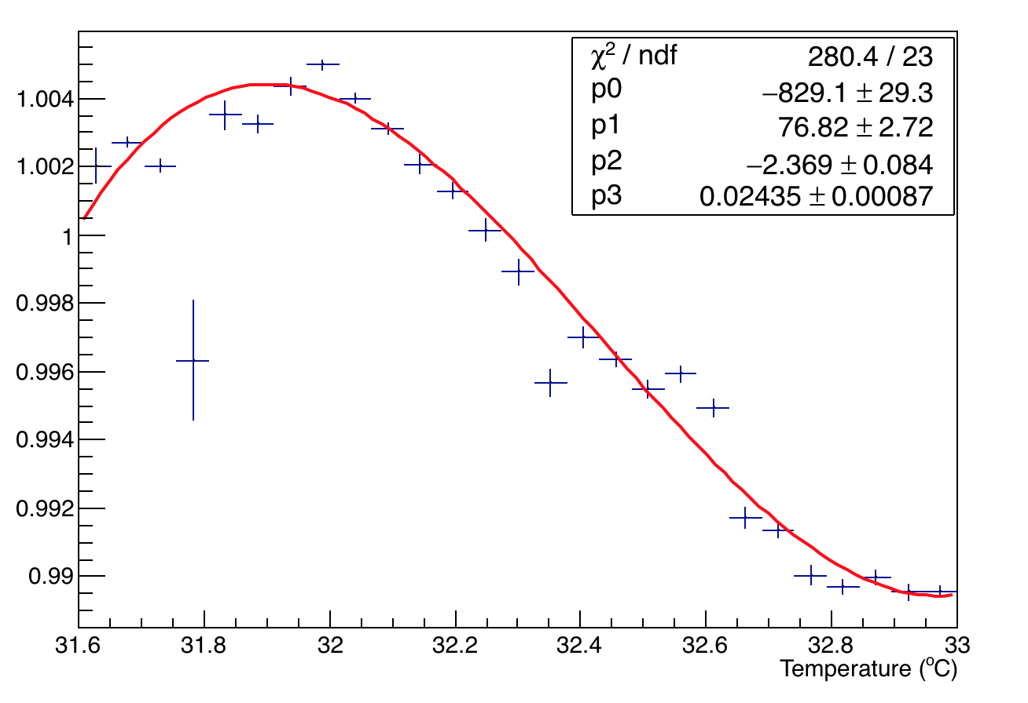
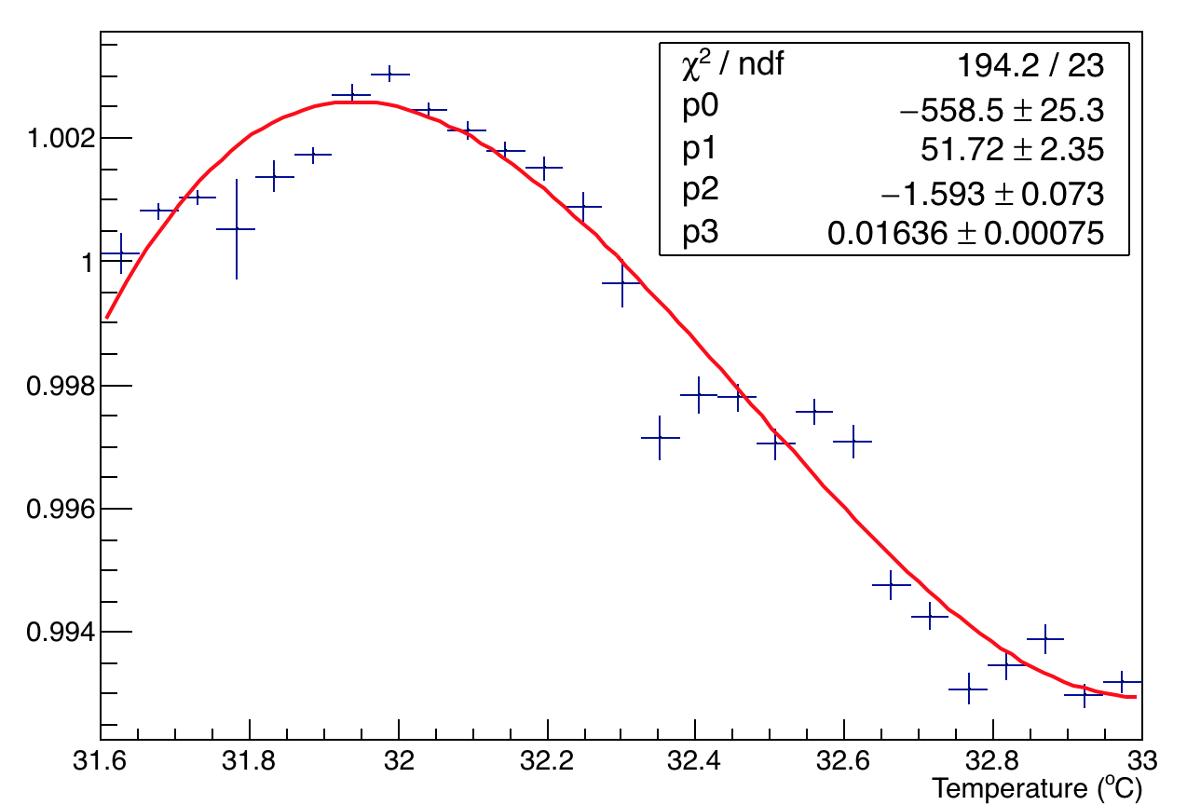
Temperature studies of channel 28
A1
A2
Used higher order fits – gives better chi2 than linear fit. A cubic fir for A2 and A2:A1
A2:A1

Slide 18
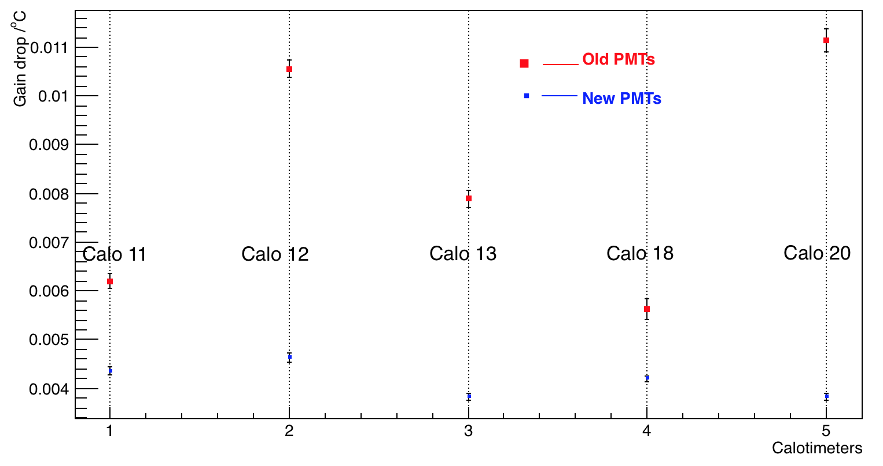
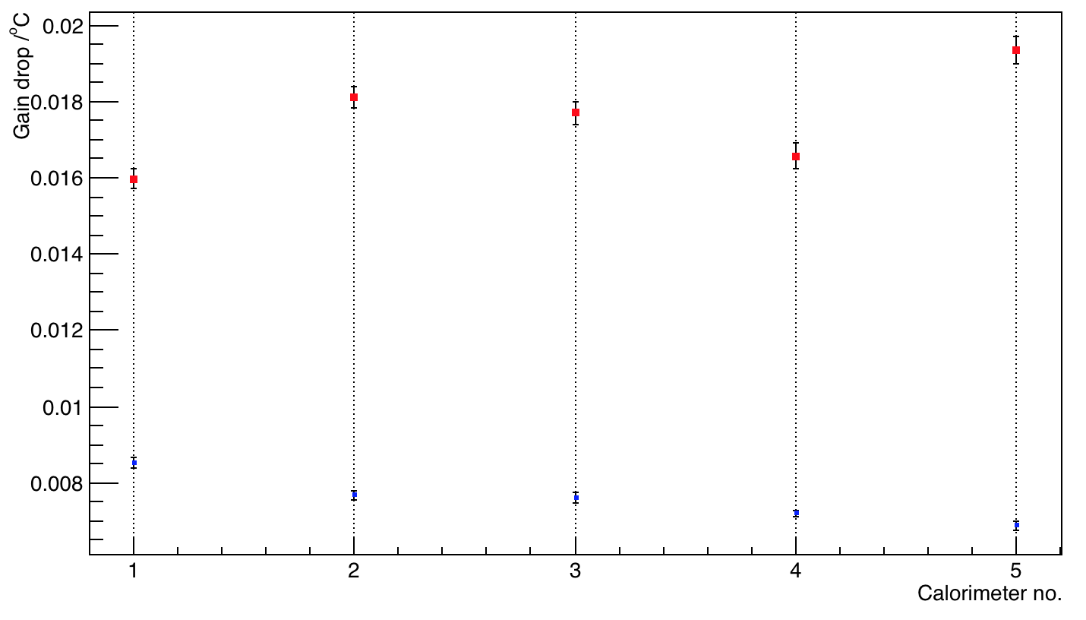
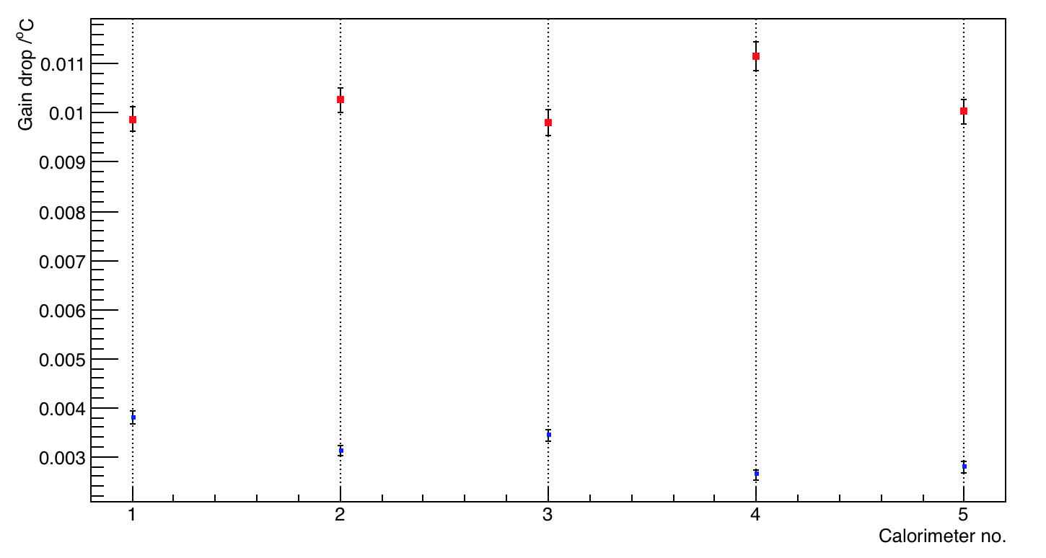
Comparison of Old and New PMTs – Gain drop with temp
Old PMTs
New PMTs
Calo 11 Calo 12 Calo 13 Calo 18 Calo 20
A1
A2
Old PMTs
Results obtained by linear fits of each calorimeter.
New PMTs
Calo 11 Calo 12 Calo 13 Calo 18 Calo 20
A2:A1

